Slide 1
How feature importance is calculated in a Random Forest classifier
Supplementary Discussion

Slide 2
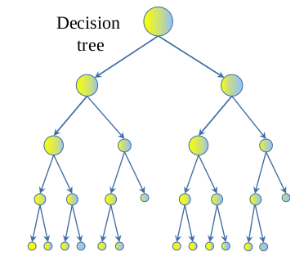
Basic Description of RF Classification*
Supervised learning
Requires training data
Basic building blocks are “Decision Trees”
Splitting data up into subgroups at each branch based on similarity
RF
‘ensemble’ of decision trees
Built from sample drawn with replacement (bootstrap)
Low correlation is key
Uncorrelated models predict better than individual trees
Info about correlated features can be lost

Slide 3

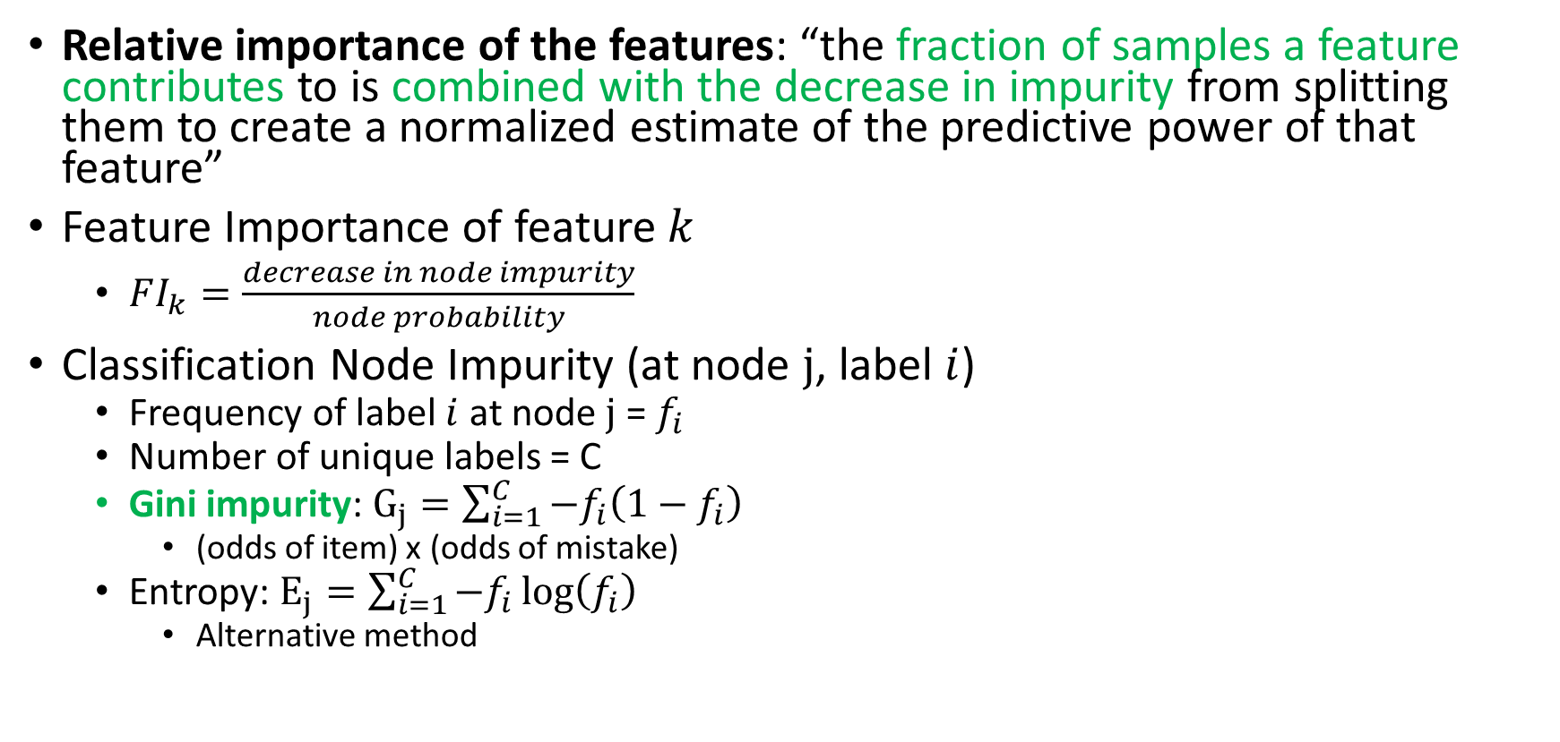
Feature Importance (in Scikit-Learn)
Relative importance of the features: “the fraction of samples a feature contributes to is combined with the decrease in impurity from splitting them to create a normalized estimate of the predictive power of that feature”
Feature Importance of feature $k$
$FI_{k}=\frac{decrease in node impurity}{node probability}$
Classification Node Impurity (at node $j$, label $i$)
Frequency of label $i$ at node $j$ = $f_{i}$
Number of unique labels = C
Gini impurity: $G_{j}=\sum_{i=1}^{C}{−f_{i}\left(1−f_{i}\right)}$
(odds of item) x (odds of mistake)
Entropy: $E_{j}=\sum_{i=1}^{C}{−f_{i}\log\left(f_{i}\right)}$
Alternative method
https://medium.com/@srnghn/the-mathematics-of-decision-trees-random-forest-and-feature-importance-in-scikit-learn-and-spark-f2861df67e3

Slide 4

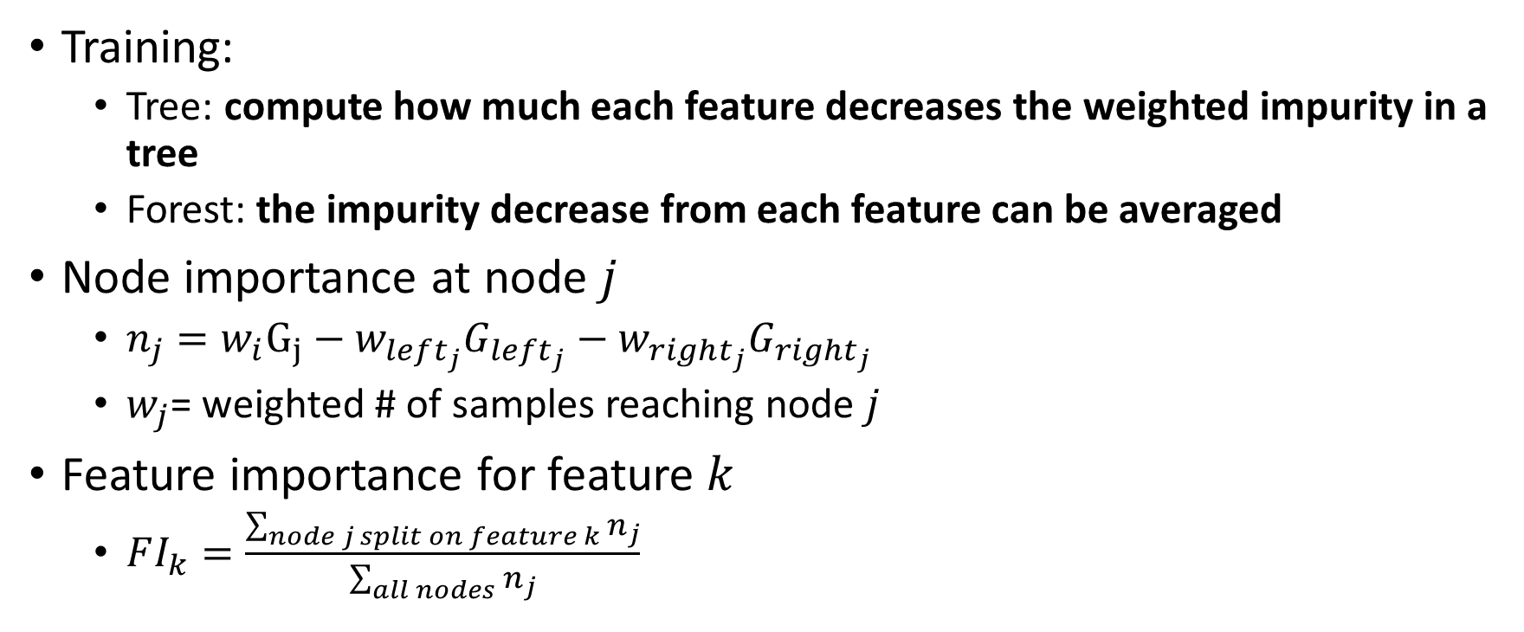


Feature Importance (in Scikit-Learn) – Tree Level
Training:
Tree: compute how much each feature decreases the weighted impurity in a tree
Forest: the impurity decrease from each feature can be averaged
Node importance at node $j$
$n_{j}=w_{i}G_{j}−w_{left_{j}}G_{left_{j}}−w_{right_{j}}G_{right_{j}}$
$w_{j}$= weighted # of samples reaching node $j$
Feature importance for feature $k$
$FI_{k}=\frac{\sum_{node j split on feature k}{n_{j}}}{\sum_{all nodes}{n_{j}}}$
Node $j$
Left child $j$
Right child $j$
http://blog.datadive.net/selecting-good-features-part-iii-random-forests/

Slide 5
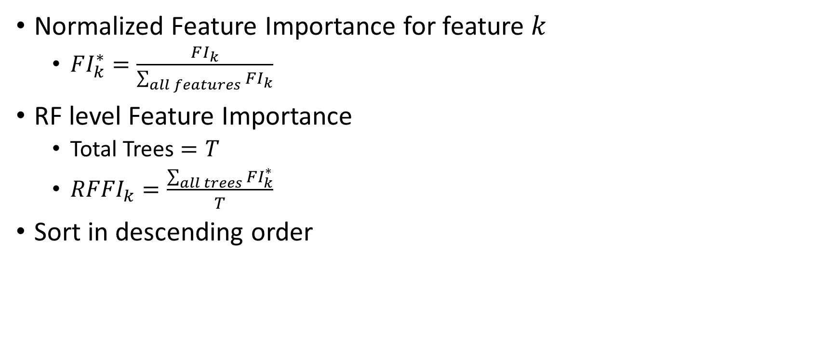
Feature Importance (in Scikit-Learn) – Forest Level
Normalized Feature Importance for feature $k$
$FI_{k}^{∗}=\frac{FI_{k}}{\sum_{all features}{FI_{k}}}$
RF level Feature Importance
Total Trees $=T$
$RFFI_{k}=\frac{\sum_{all trees}{FI_{k}^{∗}}}{T}$
Sort in descending order

Slide 6
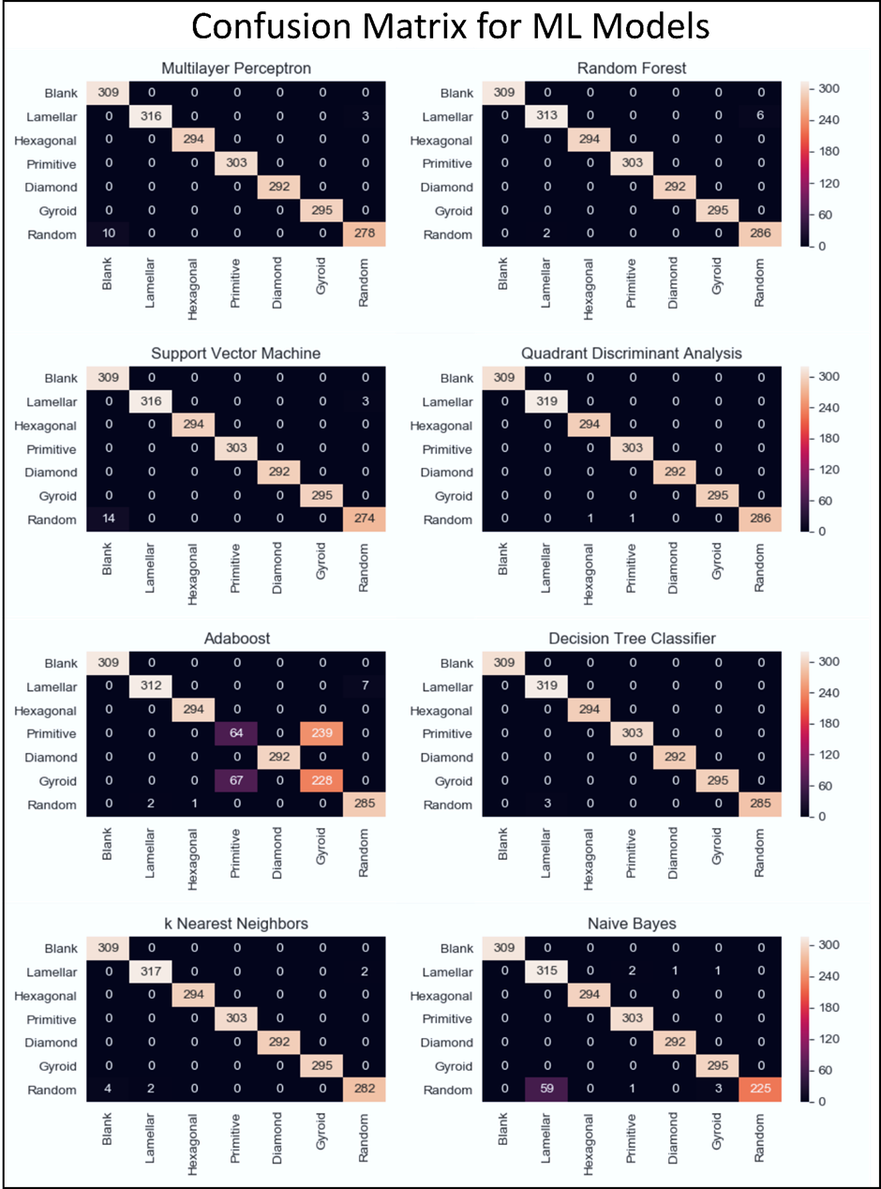
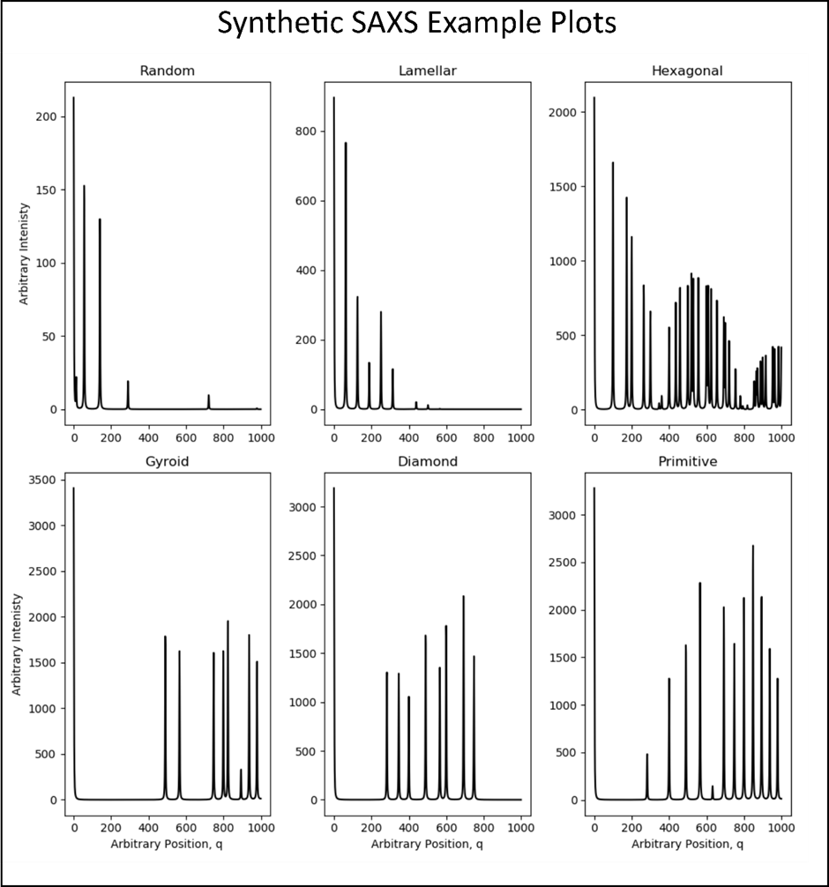
Example from my experience

Slide 7
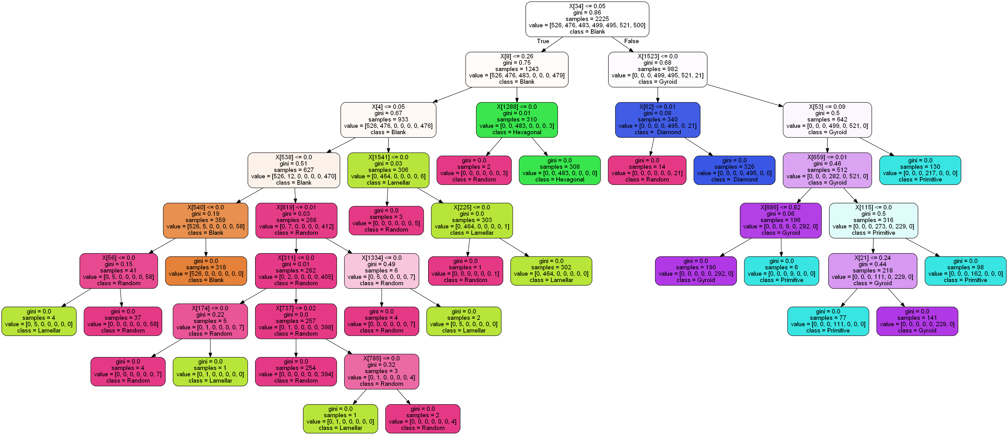
One of the trees in the forest…

Slide 8
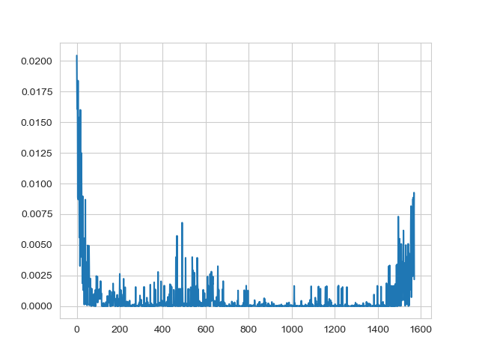
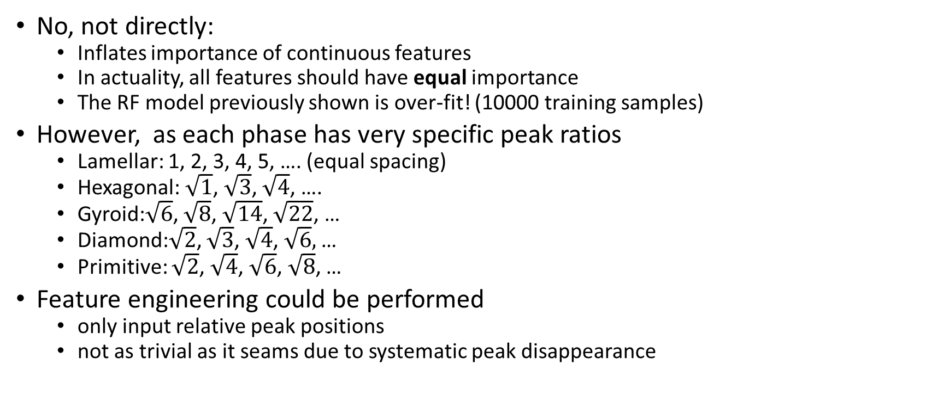
Is this appropriate for SAXS data?
No, not directly:
Inflates importance of continuous features
In actuality, all features should have equal importance
The RF model previously shown is over-fit! (10000 training samples)
However, as each phase has very specific peak ratios
Lamellar: 1, 2, 3, 4, 5, …. (equal spacing)
Hexagonal: $\sqrt{1}$, $\sqrt{3}$, $\sqrt{4}$, ….
Gyroid:$\sqrt{6}$, $\sqrt{8}$, $\sqrt{14}$, $\sqrt{22}$, …
Diamond:$\sqrt{2}$, $\sqrt{3}$, $\sqrt{4}$, $\sqrt{6},$…
Primitive: $\sqrt{2}$, $\sqrt{4}$, $\sqrt{6}$, $\sqrt{8}$, …
Feature engineering could be performed
only input relative peak positions
not as trivial as it seams due to systematic peak disappearance

